Slide 1
UNIT 7 – THE MASS MEDIA
PART B: SPEAKING

Slide 2





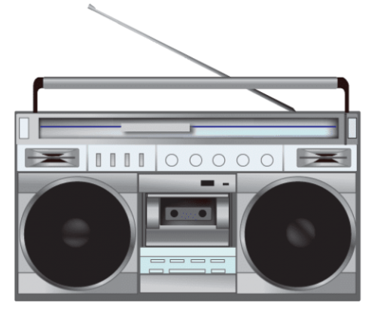



Task 1: Which of the following are the types of the MASS MEDIA ?

Slide 3

Orally /ˈɔːrəli/ (adv)
= through mouth
: bằng miệng

Slide 4

Aurally /ˈɔːrəli/ (adv)
= through ears
: bằng tai

Slide 5

Visually /ˈvɪʒuəli/ (adv)
= through eyes
: bằng mắt

Slide 6

Present /prɪˈzent/ (v)
: trình bày, bày tỏ
Ex: She presents the late-night news.

Slide 7

Deliver /dɪˈlɪvər/ (v)
= transmit
: truyền đi

Slide 8

Distinctive /dɪˈstɪŋktɪv/ (a)
= different
: khác biệt

Slide 9
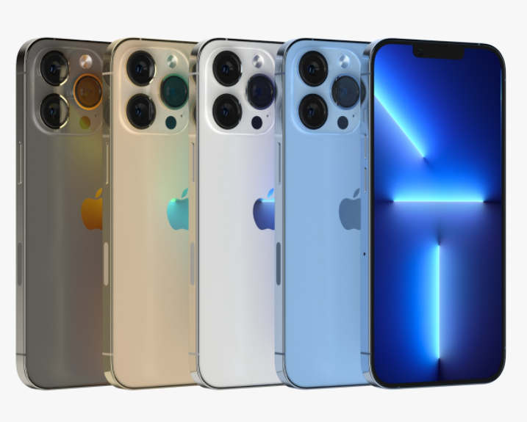
Feature /ˈfiːtʃər/ (n)
: đặc điểm
Ex: The latest model of IPhone has several new features.

Slide 10
New words
  Orally (adv) /’ɔ:rəli/ bằng lời nói
  Aurally (adv) /’ɔ:rəli / bằng cách nghe
  Visually (adv) /'vizjuəli/ bằng thị giác
  Present (v) /pri'zent/ trình bày, bày tỏ
  Deliver (v) /di'livə/ truyền đi
  Distinctive (a) /dɪˈstɪŋktɪv/ khác biệt
  Feature (n) /'fi:tʃə/ điểm đặc trưng

Slide 11


Task 2:
 | The mass media Provide/present information and entertainment |  |  | People Get/ receive information and entertainment
 | Orally | Visually | Aurally | Orally | Visually | Aurally
Radio
Newspapers
Television
The Internet

Slide 12
Provide information and entertainment orally.
Receive information aurally.

Slide 13
Present information and entertainment visually.
Receive information visually.

Slide 14
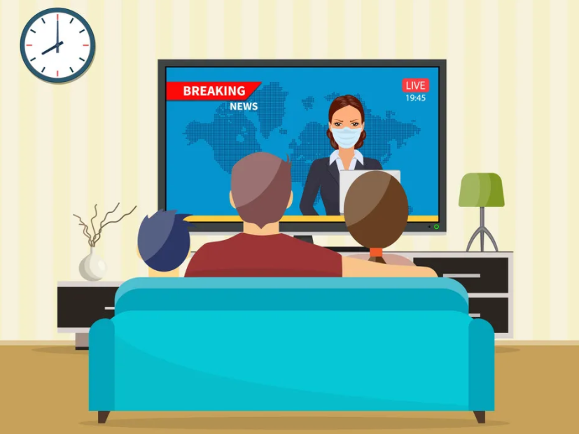
Present information and entertainment orally and visually.
Get information aurally and visually.

Slide 15

Provide information and entertainment orally and visually.
Get information and entertainment visually and aurally.

Slide 16
THANK YOU

